Slide 1
CATERO CATERING MANAGEMENT SYSTEM
Members: Mentored by:
Ajay sharma - U101116FCS006 Amit Kumar Sir
Cvn Sai Koushik - U101116FCS024
Desu Lohith - U101116FEC159
Ashish bisht - U101116FCS015 Student mentor:
Mitul kumar - U101116FCS068 Surabhi Chaitanya

Slide 2
NOVELTY
The following article provides the novelty of our project idea and the solution developed as part of our project work in the course Software engineering. With our software Catero, more than 500 clients of our client from Vijayawada are going to experience online catering services for the first time in history. Our project is developing a dynamic website for a Catering management system that is accessible to users from both the computer over a Stable web connection. Having a website is an absolute necessity for most businesses today.
Statistics Are Overwhelming: Digital Orders Are Rising. To stay current, we developed a website for our customer in order to increase his sales as the catering service is already so popular so this might add up to their business and help increase in their sales and profits.

Slide 3
Sophistication Value of the Project
Google Sign-in:
This was one complex task where we had to burn some midnight oil for setting up Google SignIn using google console api by generating Oauth2 authentication.
Image Retrieving
Coding using JSP and Servlet:
After all , coding in jsp and servlets didn’t turn out to be an easy task. Though it was hard , we chose it cause we believed it would give the perfect result for our expectations .

Slide 4
Nature of Customer
There are always positive and negative feedback from our customer according to his need. As we are the development team and the project is just being developed by us and it is developed for our customer who intends to use this web application for his business growth. In this way we have only one customer for our project technically , with whom we regularly interact. As far as his nature is considered , he expected a decent work from us and which would turn out a good catering order platform who intends to order food from online. We generalized all the requirements of a customer ordering which we wanted to include as features of our web app before we started our work and let our customer know it , so that , we could add any features he’d say beforehand to the blueprint and make our work easier. Our customer was quite happy with the included features and waved a green flag.

Slide 5
Applicability of the Project
The purpose of this phase is to present a detail description about the applicability of our project Catero. The purpose of the Catering management service is to create a convenient and easy-to-use web application for customers, trying to book the orders.

Slide 6
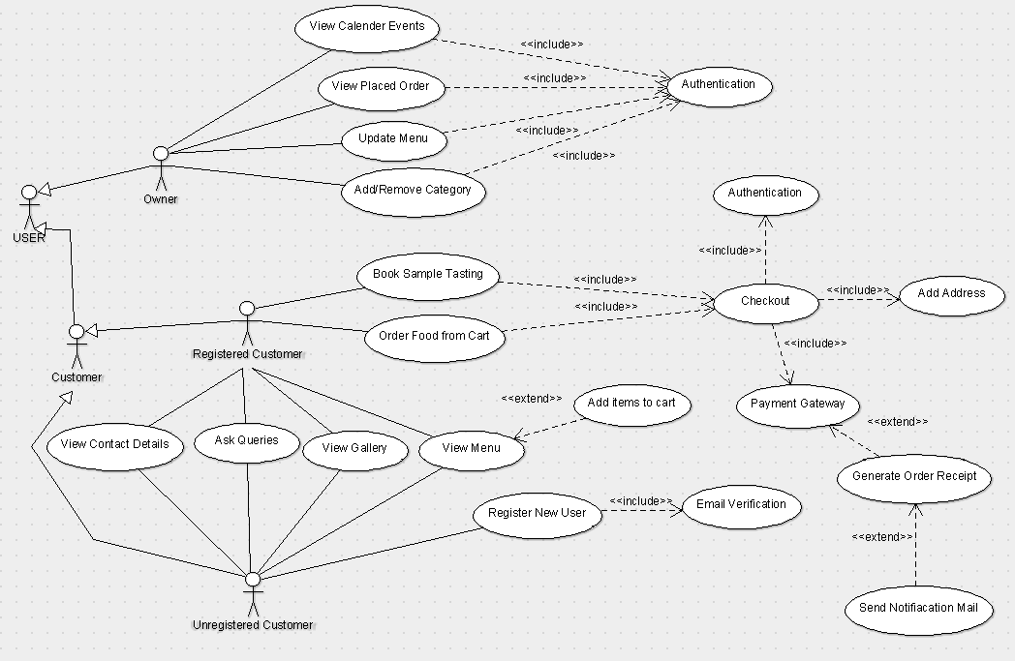
Use Case Diagram

Slide 7
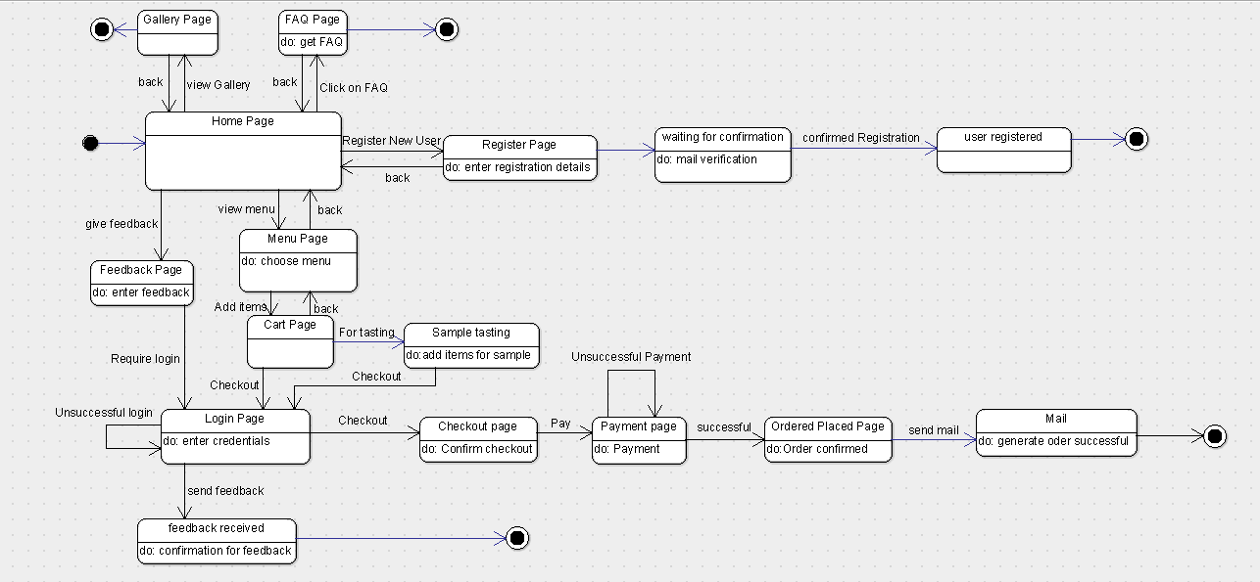
State diagram User

Slide 8
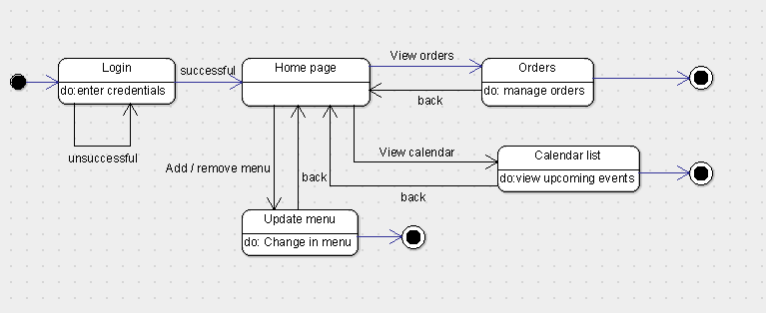
Admin side

Slide 9
Tools and Technologies used during the project development:
Tools for Specification
ArgoUML
MS Word
Sublime Text
Tools for Design
Tools for Documentation
MS Word
Google Docs
Sublime Text
PDF Converter
Snipping Tool

Slide 10
Technologies :
HTML
CSS
Java Script
Servlets
My SQL
GIT

Slide 11
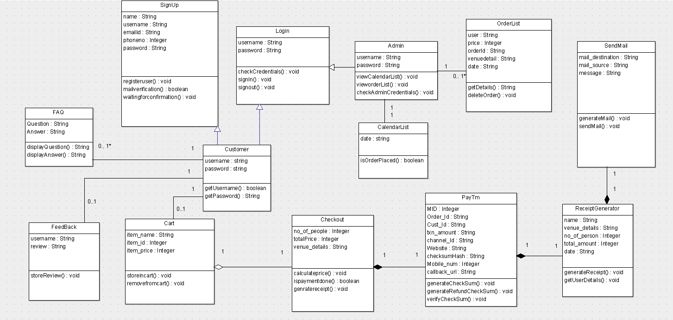
Class Diagram

Slide 12
Coding Metrics
Baseline | Description
Files # | 20
Lines # | 1163
Statements # | 737
% branches | 6.4
Calls # | 340
% Comments | 24.3
Classes # | 22
Methods/Class # | 2.77
Avg.statements/methods | 6.15
Max complexity | 14*
Max depth | 6
Avg .depth | 1.51
Avg.complexity | 1.79*

Slide 13
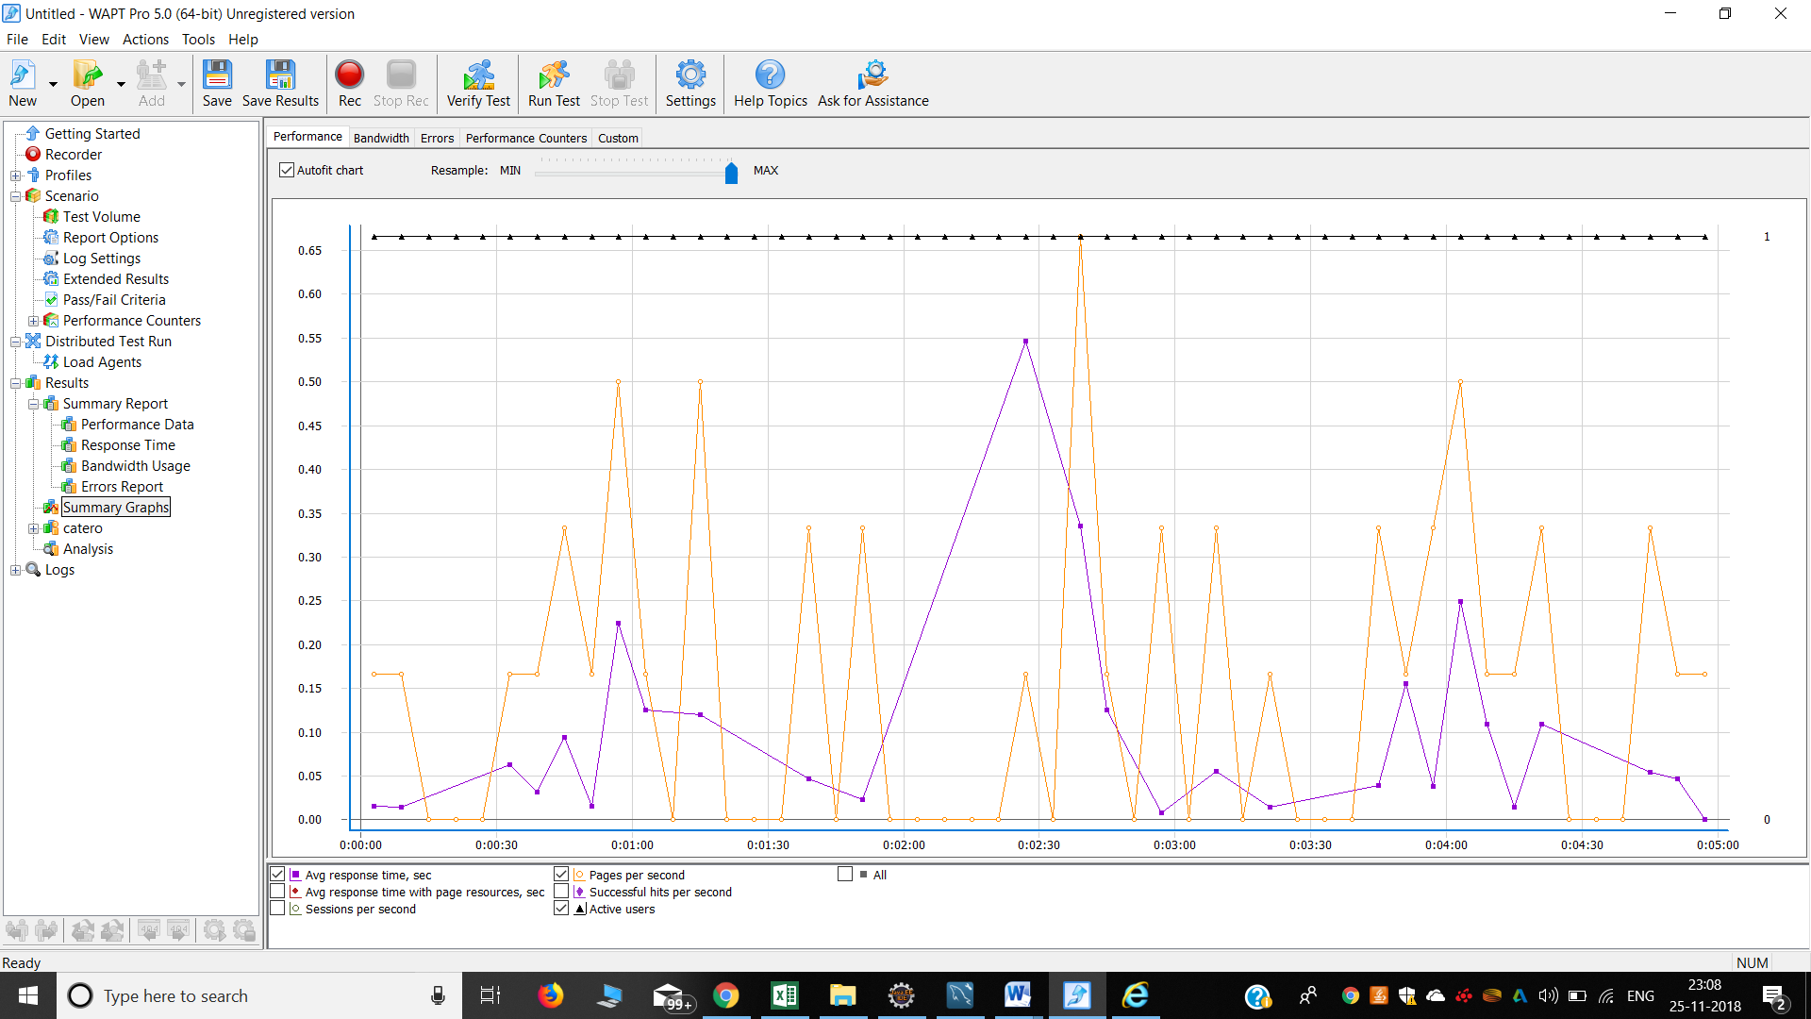
Performance Testing Summary

Slide 14
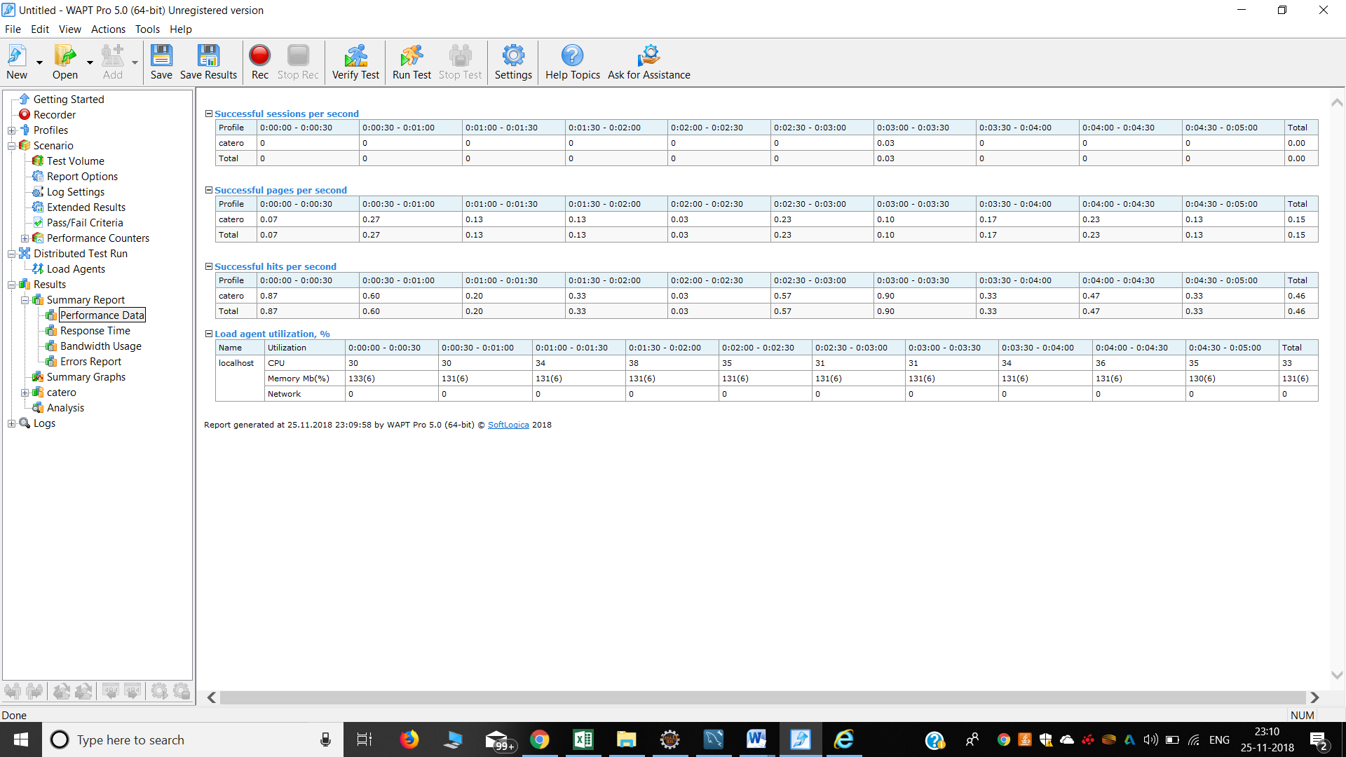
Performance Data

Slide 15
Minutes of meeting
The Catero team worked on a commercial purpose to meet the need of our Customer who wants to start a catering website for their catering service which is being run successfully from many years.

Slide 16
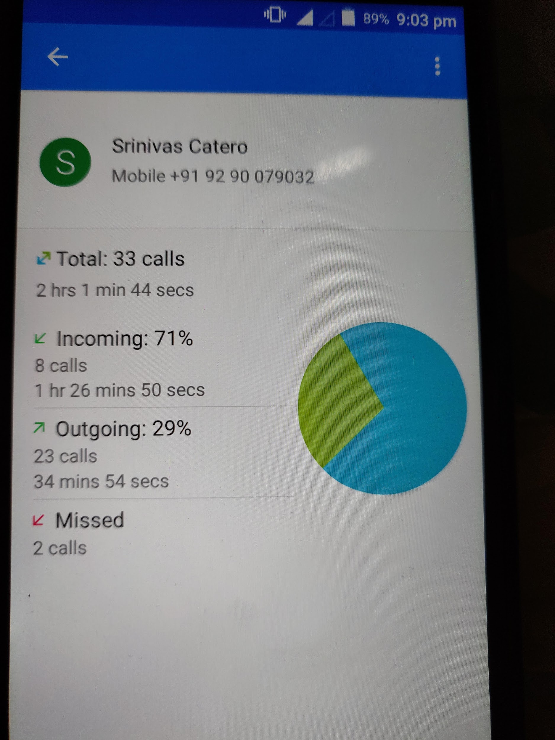
Minutes of meeting
Phone Calls log with Client:

Slide 17
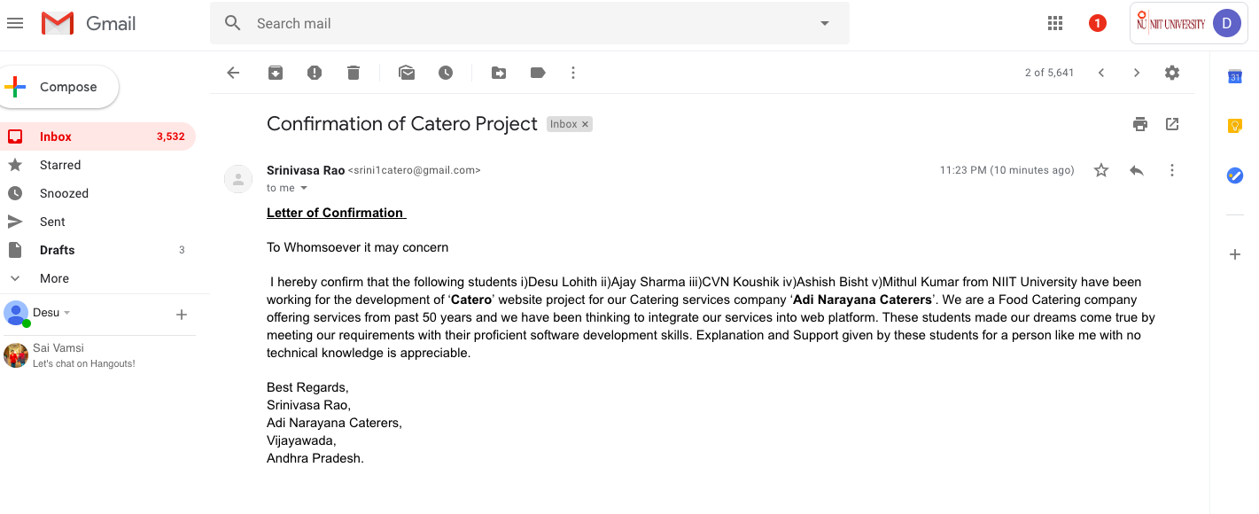
Minutes of meeting (Email )
Screenshot of Mail Confirmation by Client:

Slide 18
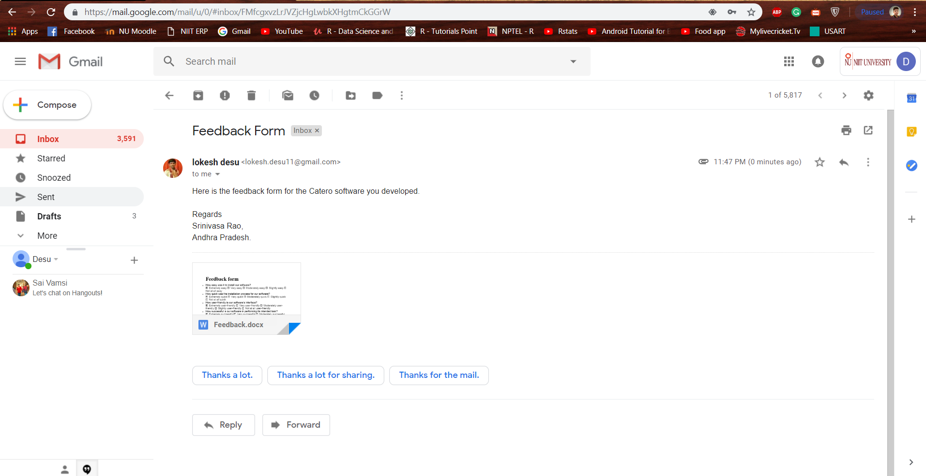
Feedback form

Slide 19
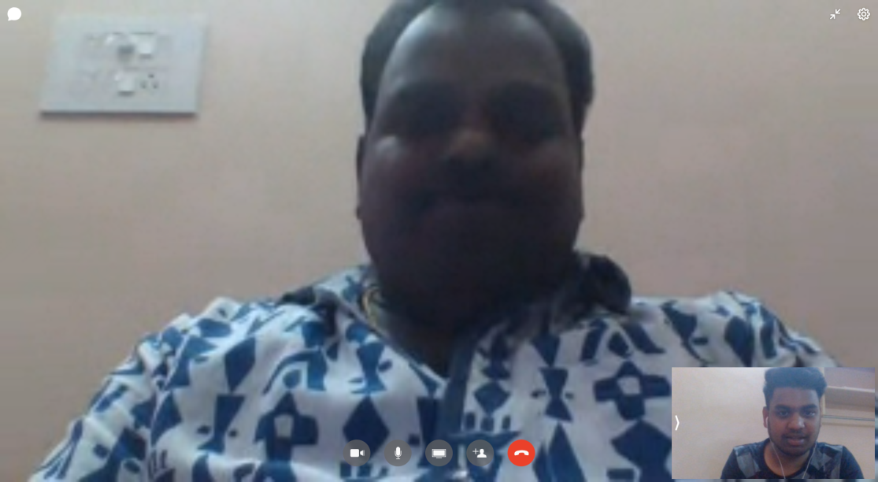
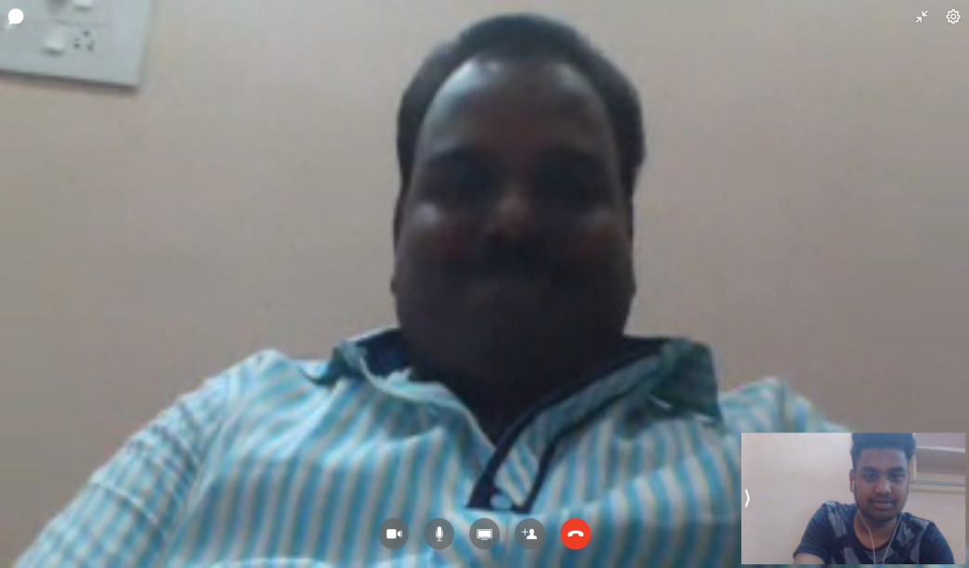
Video call screen shots with customer

Slide 20
Video link of customer about Catero
https://drive.google.com/file/d/1CPZ_Y1J-D67HJSCdSCgXCSObQhgqb-4A/view?usp=drivesdk

Slide 21


